Slide 1
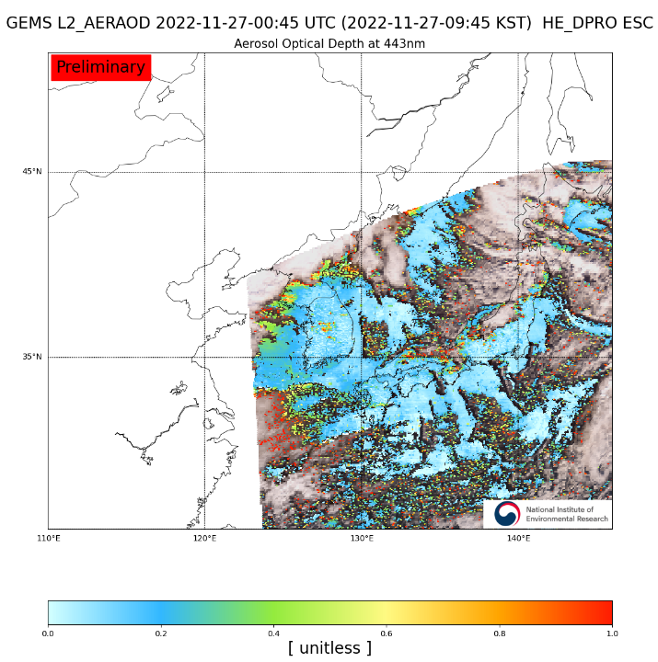
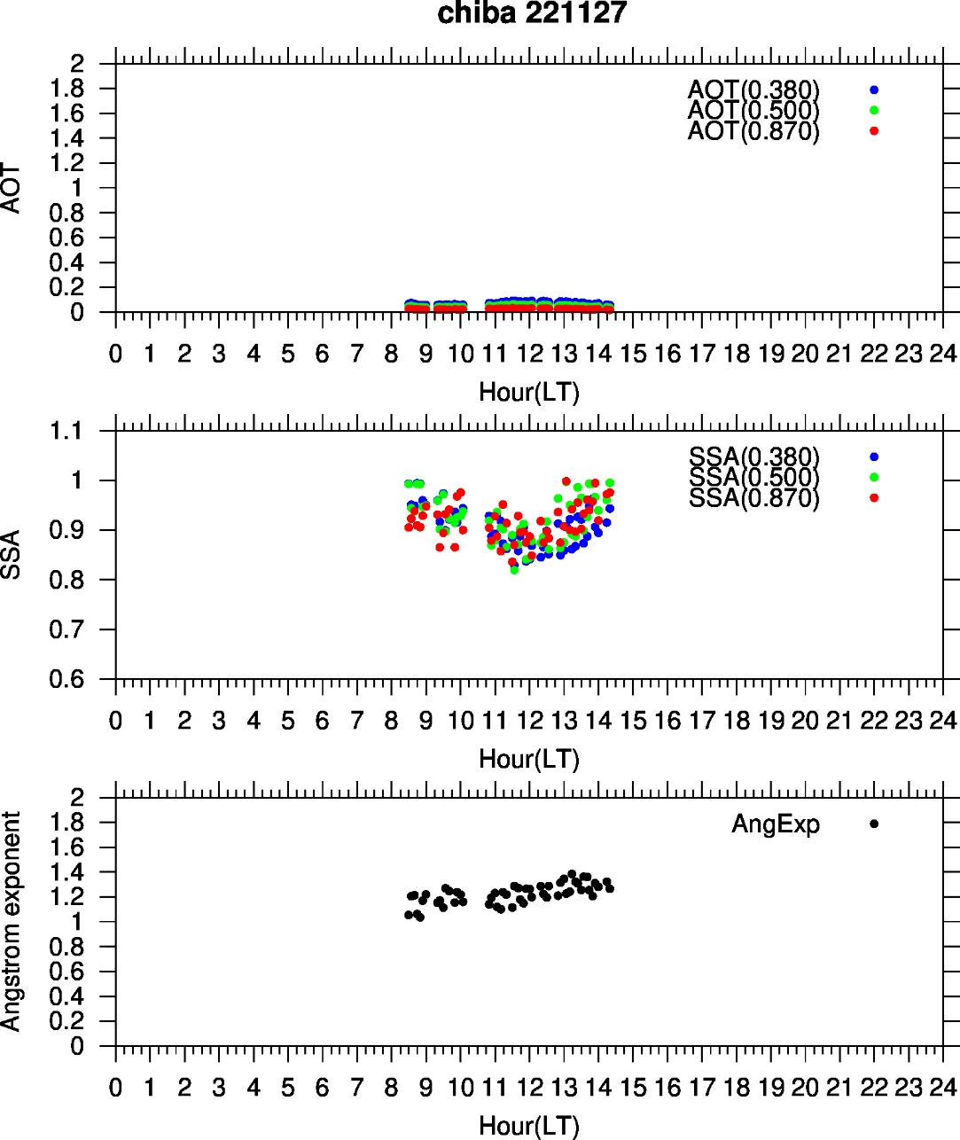
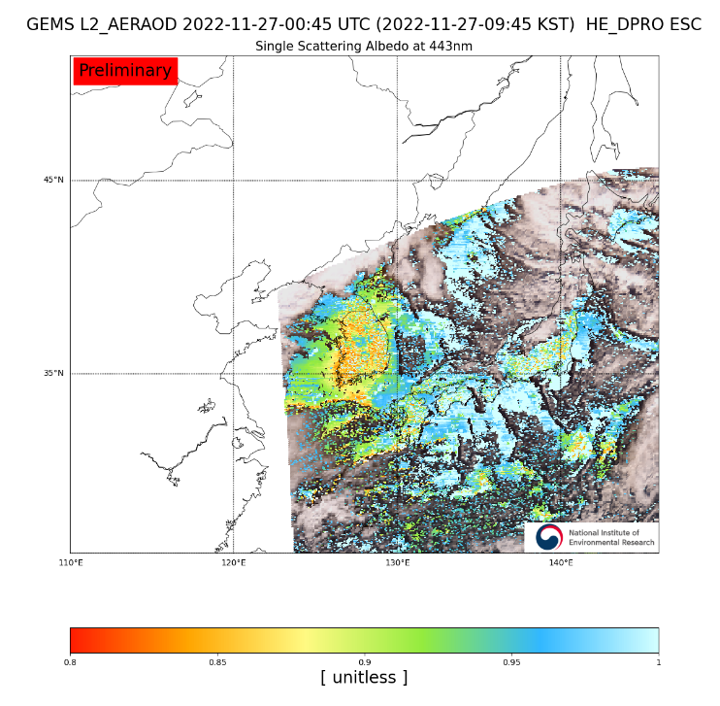
Comparison with GEMS data for 20221127
GEMS
skyradiometer
AOD443
GEMS obs.
Chiba
SSA443
Chiba

